Slide 1

WHAT IT TAKES TO WIN
Robert Riddell

Slide 2
Executive Summary
The average number of points scored by teams when they win is 86 and when they lose is 70.
If the team finishes the tournament in the top 4 their average number of points when winning is 89 and 84 when they lose
If a teams wants to progress, they must be able to score in the 80’s and if they want to win tournaments, they need to be in the high 80’s – 90s
What is the relationship between winning and other statistics that could be used to predicts a team's success

Slide 3
Predicting Future Success
The teams who finished in the top four:
Made 4 more shots per game and attempted 2
Made 1 more 3 pointer per game
Made 3 more free throws and attempted 4 more
Recorded 3 more total rebounds
Recorded 3 more assists
Got 1 more steal
Recorded 1 less turnover
Shot 5% better from the field

Slide 4
The data
Data scraped from Basketball Reference as player box scores, then combined.
Olympic Games 2000 – 2016 (198 games)
Fiba World Cup 2010, 2014 and 2019 (248 games)
Total of 448 games from 42 individual teams
15 initial statistics provided and 11 more created from existing data

Slide 5
Method
Assess the statistical similarity between teams that have a top four finish
01
Build multiple models to predict how many will be scored in a given game based on the statistic output
02
Build multiple model to predict if a team will Win or Lose based on the statistic output
03
Analyse the results to determine which statistics are valuable in predicting performance
04

Slide 6
Commonality of top four finishes
Top Four Finishes
Country | World Cups (3) | Olympics (5) | Total (8)
United States | 2 | 5 | 7
Lithuania | 2 | 3 | 5
Spain | 1 | 3 | 4
France | 2 | 1 | 3
Serbia | 2 | 1 | 3
Argentina | 1 | 2 | 3
Australia | 1 | 2 | 3
Turkey | 1 | 0 | 1
Greece | 0 | 1 | 1
Puerto Rico | 0 | 1 | 1
Russia | 0 | 1 | 1
Notes:
AST, Efg_p, fg_p, fg vs points grouped by top 4

Slide 7
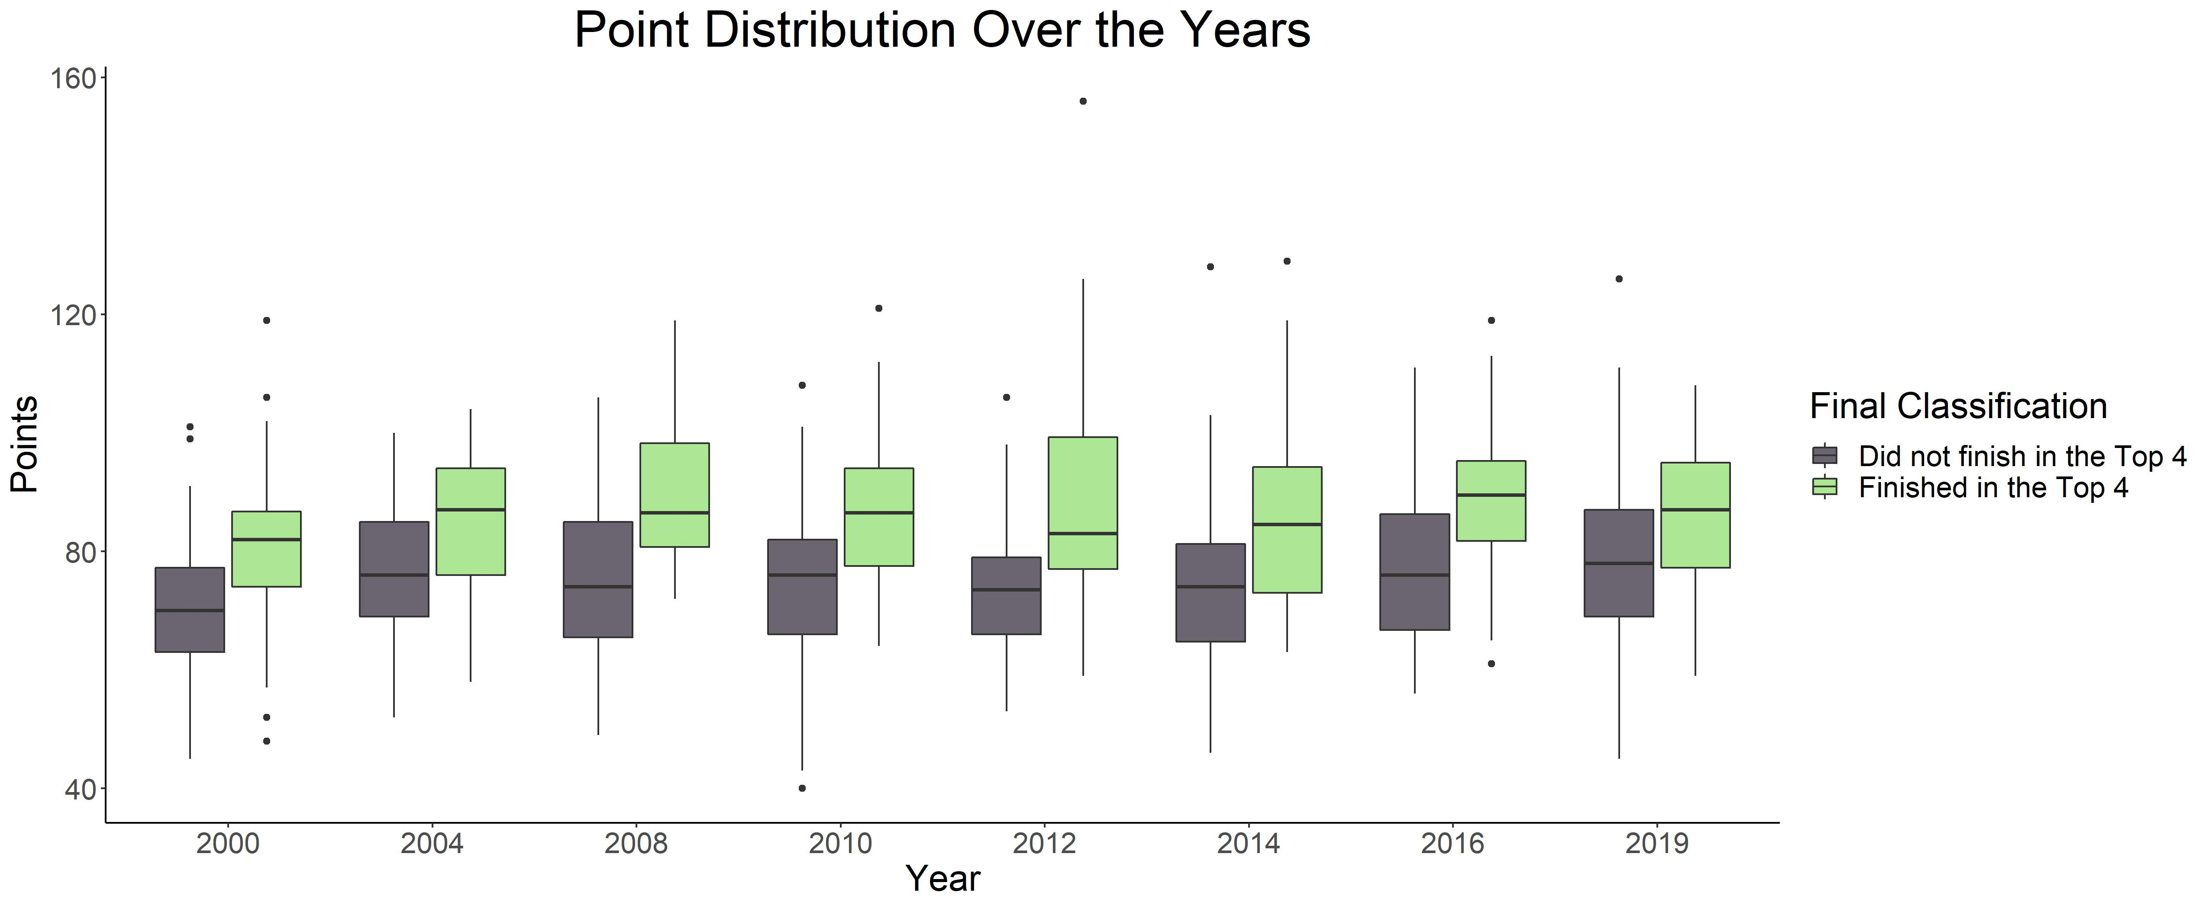
Commonality of top four finishes
Teams that finish in the top four consistently score more points

Slide 8
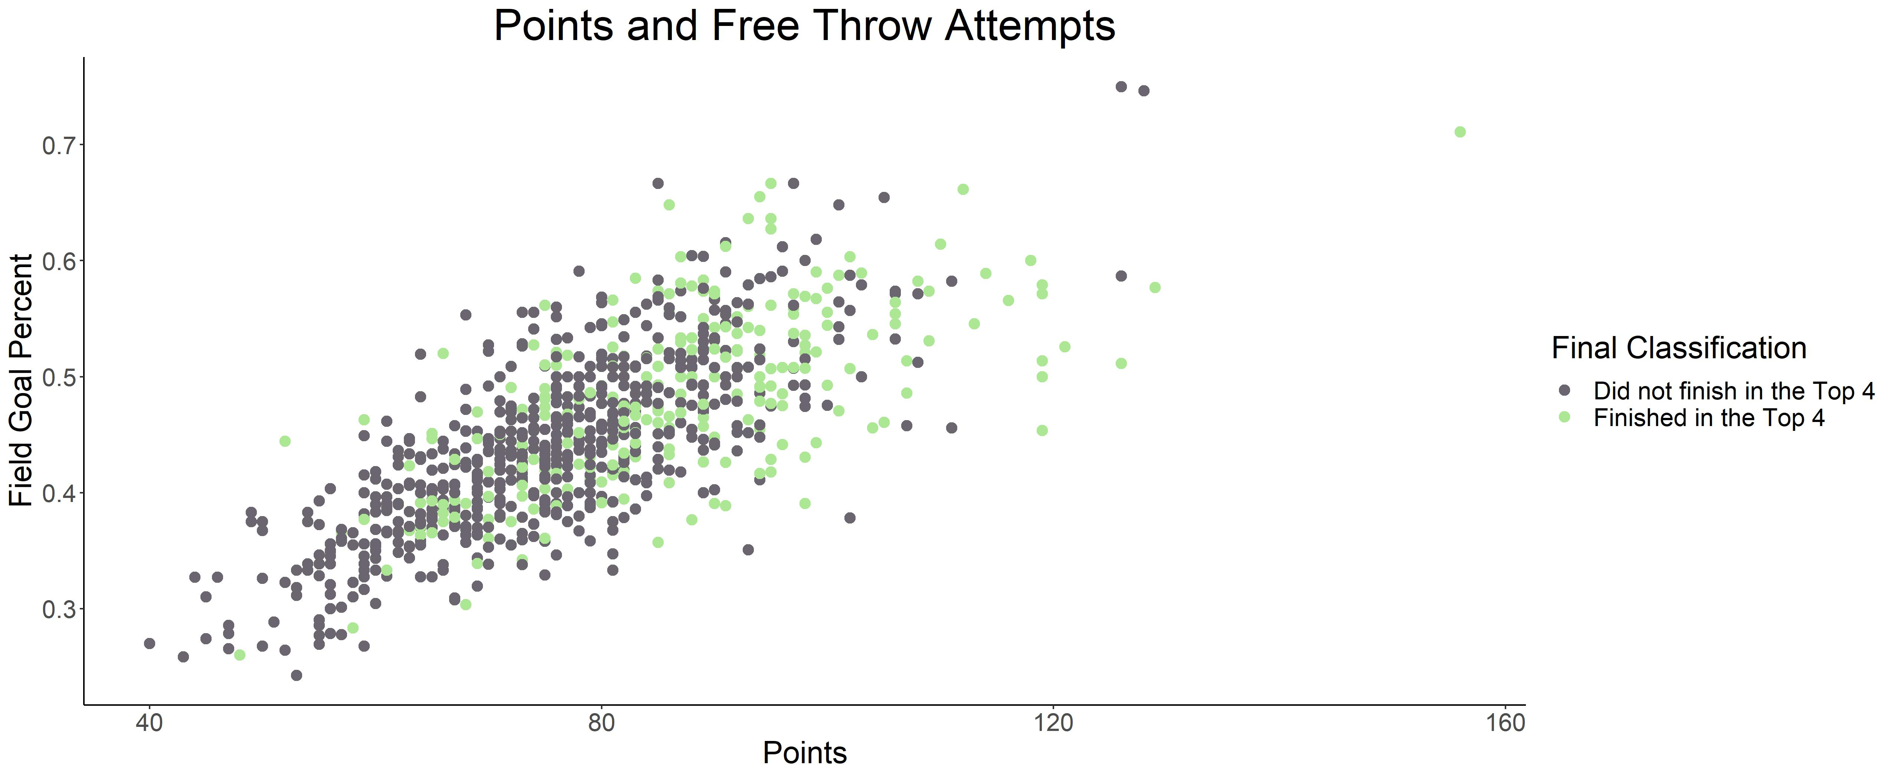
Top Four Team Comparison – FG%
Notes:
AST, Efg_p, fg_p, fg vs points grouped by top 4

Slide 9
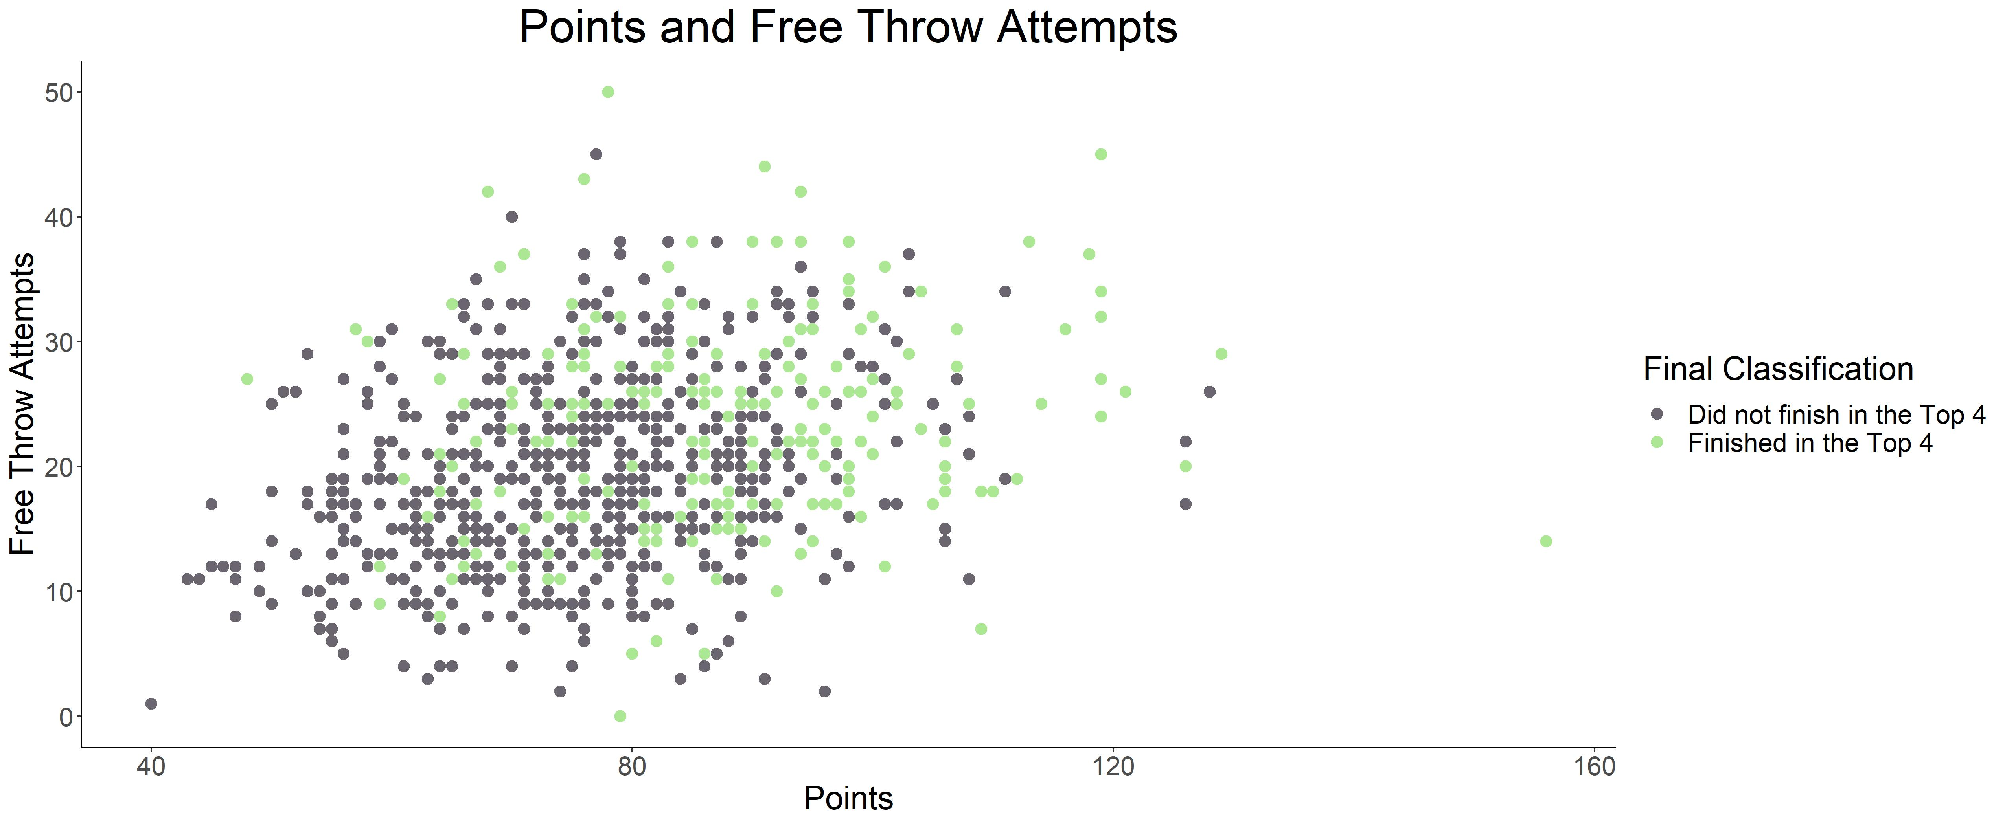
Top Four Team Comparison - FTA
Notes:
AST, Efg_p, fg_p, fg vs points grouped by top 4

Slide 10
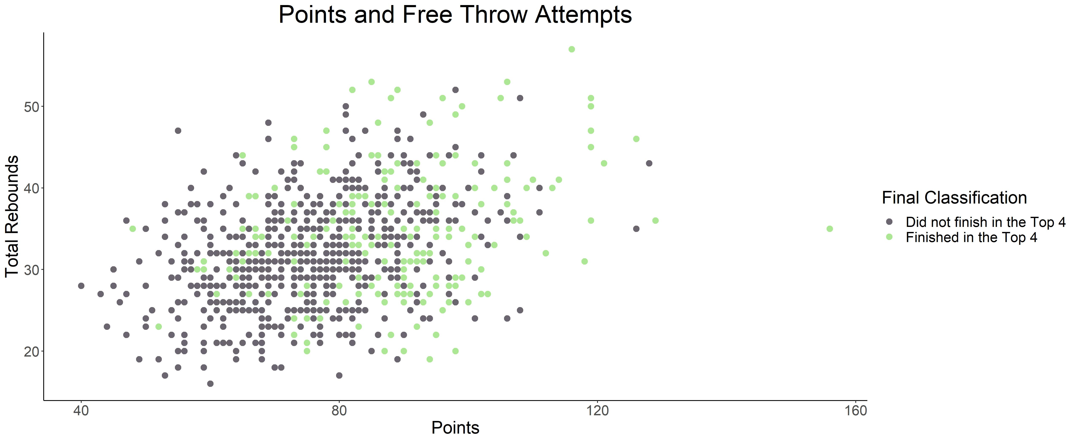
Top Four Team Comparison - TRB
Notes:
AST, Efg_p, fg_p, fg vs points grouped by top 4

Slide 11

Predicting Points – Exploratory Data Analysis
Exploratory Data Analysis
Notes:
show the lower relationship with pts and BLK, ft_p
and the higher correlation with ts_p

Slide 12
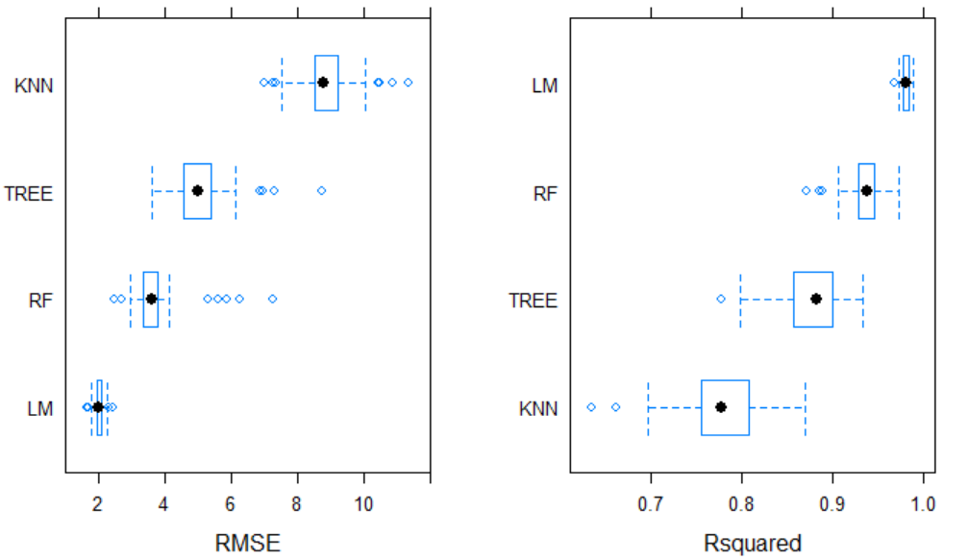
Predicting points - Results
Feature selection
Models used
Multiple Linear Regression (LM)
K – Nearest Neighbours (KNN)
Decision Tree
Random Forest
Evaluated by RMSE and R² value
Notes:
Explain that I put a smaller number of features through a KNN, Decision tree, Random forest and Multiple linear regression model
explain the RMSE and R-squared values
The final results being the linear model can predict a teams points to ~1.9 each time.

Slide 13
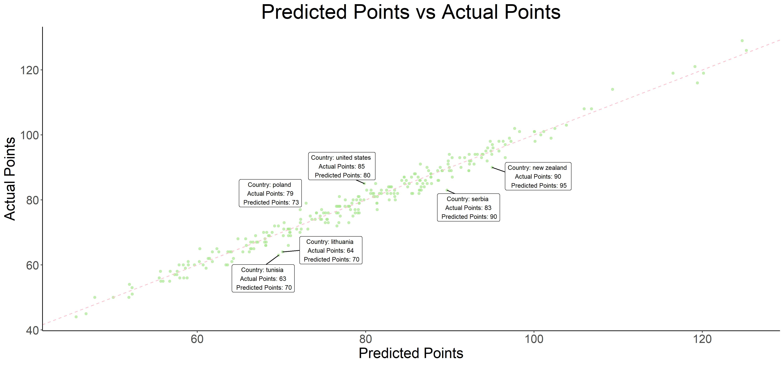
Multiple Linear Model Results

Slide 14

Variable Importance
These are the values the linear regression model regards as important
Variable Importance Multiple Linear Model
3 Points Attempts
Free Throws Attempted
Field Goals Made
Mean PER
Turnovers
Offensive Rebounds
Team Possessions

Slide 15

Predicting Wins - EDA
Exploratory Data Analysis
Notes:
Winning teams have a higher number of fg_p, drb
similar 3pa, pf

Slide 16
Predicting Wins/Losses - results
Confusion Matrix
 | Loss Actual | Win Actual
Loss Prediction | 122 | 19
Win Prediction | 11 | 114
The classification algorithm used were decision tree, random forest and logistic regression
The best performing model was logistic regression Predicting 120 losses, 121 Wins correctly
The model mis predicted 19 losses as wins and 11 wins as losses

Slide 17
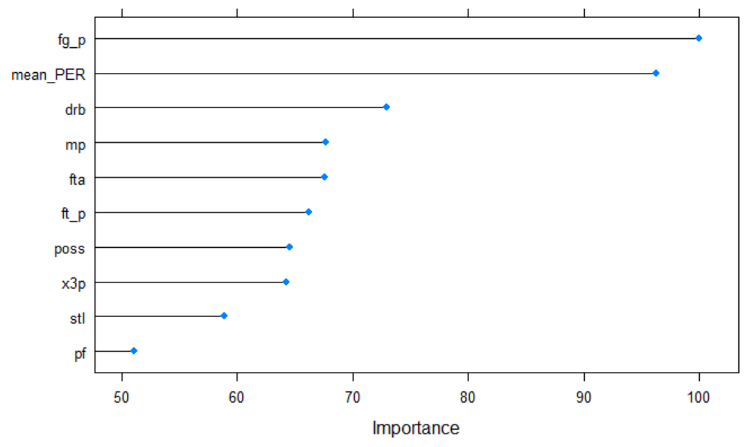
Variable Importance
These are the values the logistic regression model regards as important

Slide 18
Areas to assess to predict success
Mean Statistics from Top Four Finishing Teams
Field Goals | Free Throw Attempted | Free Throw Percent | 3 Pointers Made | 3 Pointers Attempted | Personal Fouls
30.72 | 22.57 | 73% | 8.48 | 22.73 | 21.15
Steals | Blocks | Turnovers | Offensive Rebounds | Defensive Rebounds | Mean PER
7.47 | 3.07 | 12.7 | 9.74 | 24.48 | 4.49
Based on the variable importance from the models the stats that are the best predictors of points
This could be used as a benchmark to predict where a team will finish and the likelihood of a top 4 finish

Slide 19
2020 Medal Matches
Gold Medal Match Predictions: France vs United States
Bronze Medal Match: Australia vs Serbia
Match | Country | FG | FTA | FG% | 3P | 3PA | PF | STL | BLK | TOV | ORB | DRB | Actual Result | Predicted Result | Actual Points | Predicted Points
Gold medal | France | 27 | 29 | 62% | 10 | 31 | 19 | 3 | 0 | 19 | 11 | 30 | L | L | 82 | 83.79
Gold medal | United States | 32 | 21 | 67% | 9 | 32 | 22 | 9 | 5 | 9 | 10 | 24 | W | W | 87 | 87.23
Bronze medal | Serbia | 35 | 13 | 84% | 13 | 35 | 23 | 6 | 1 | 17 | 11 | 28 | L | W | 93 | 94.3
Bronze medal | Australia | 40 | 18 | 72% | 14 | 38 | 17 | 8 | 2 | 10 | 8 | 24 | W | W | 107 | 106
Average of top 4 placing teams |  | 30.72 | 22.57 | 73% | 8.48 | 22.73 | 21.15 | 7.47 | 3.07 | 12.7 | 9.74 | 24.48

Slide 20

Future work
What domestic league are medal winning players playing in?
What is the translation of domestic league statistics to the international game?
How does Junior international success translate to senior success?

Slide 21
Links
Shiny URL
https://sport-data-insights.shinyapps.io/Basketball_Exploratory_Data_Analysis/
GitHub repository
https://github.com/RobertRiddell/Olympic-Basketball
Basketball Glossary and Data
https://www.basketball-reference.com/

Slide 22
Photos
Markus Spiske – Slide 7
Ryan Graybill – Slide 15
Marcel Schreiber – Slide 10
Jc dela Cuesta – Slide 11

